Slide 1

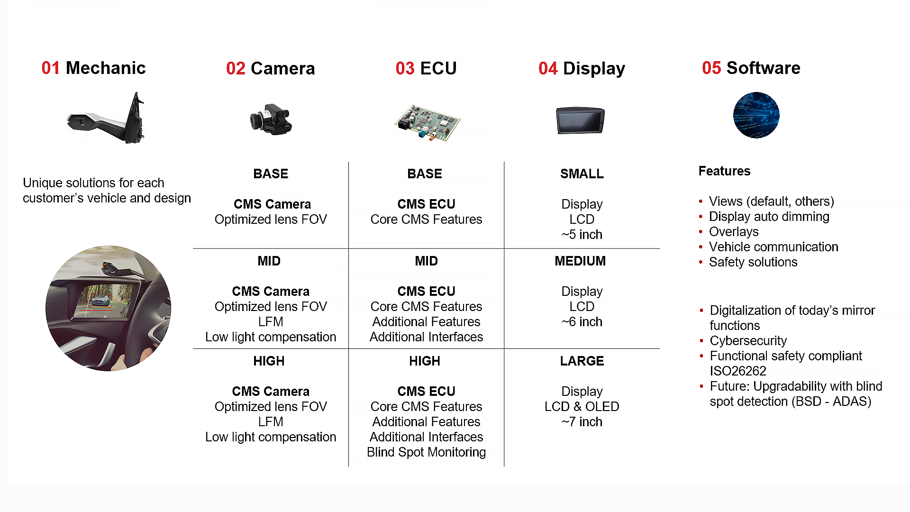
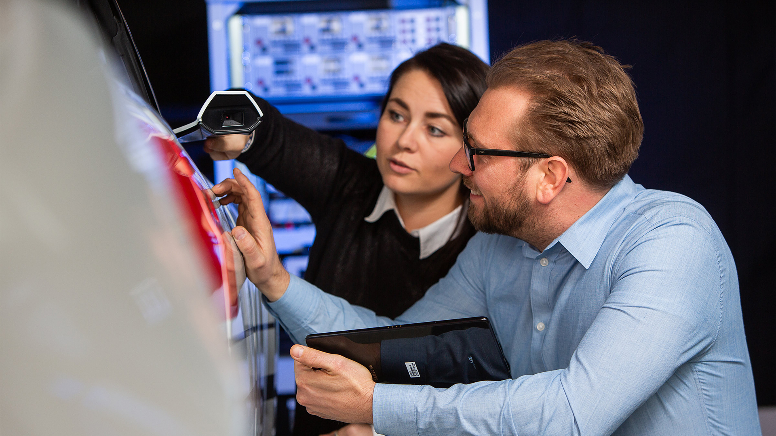
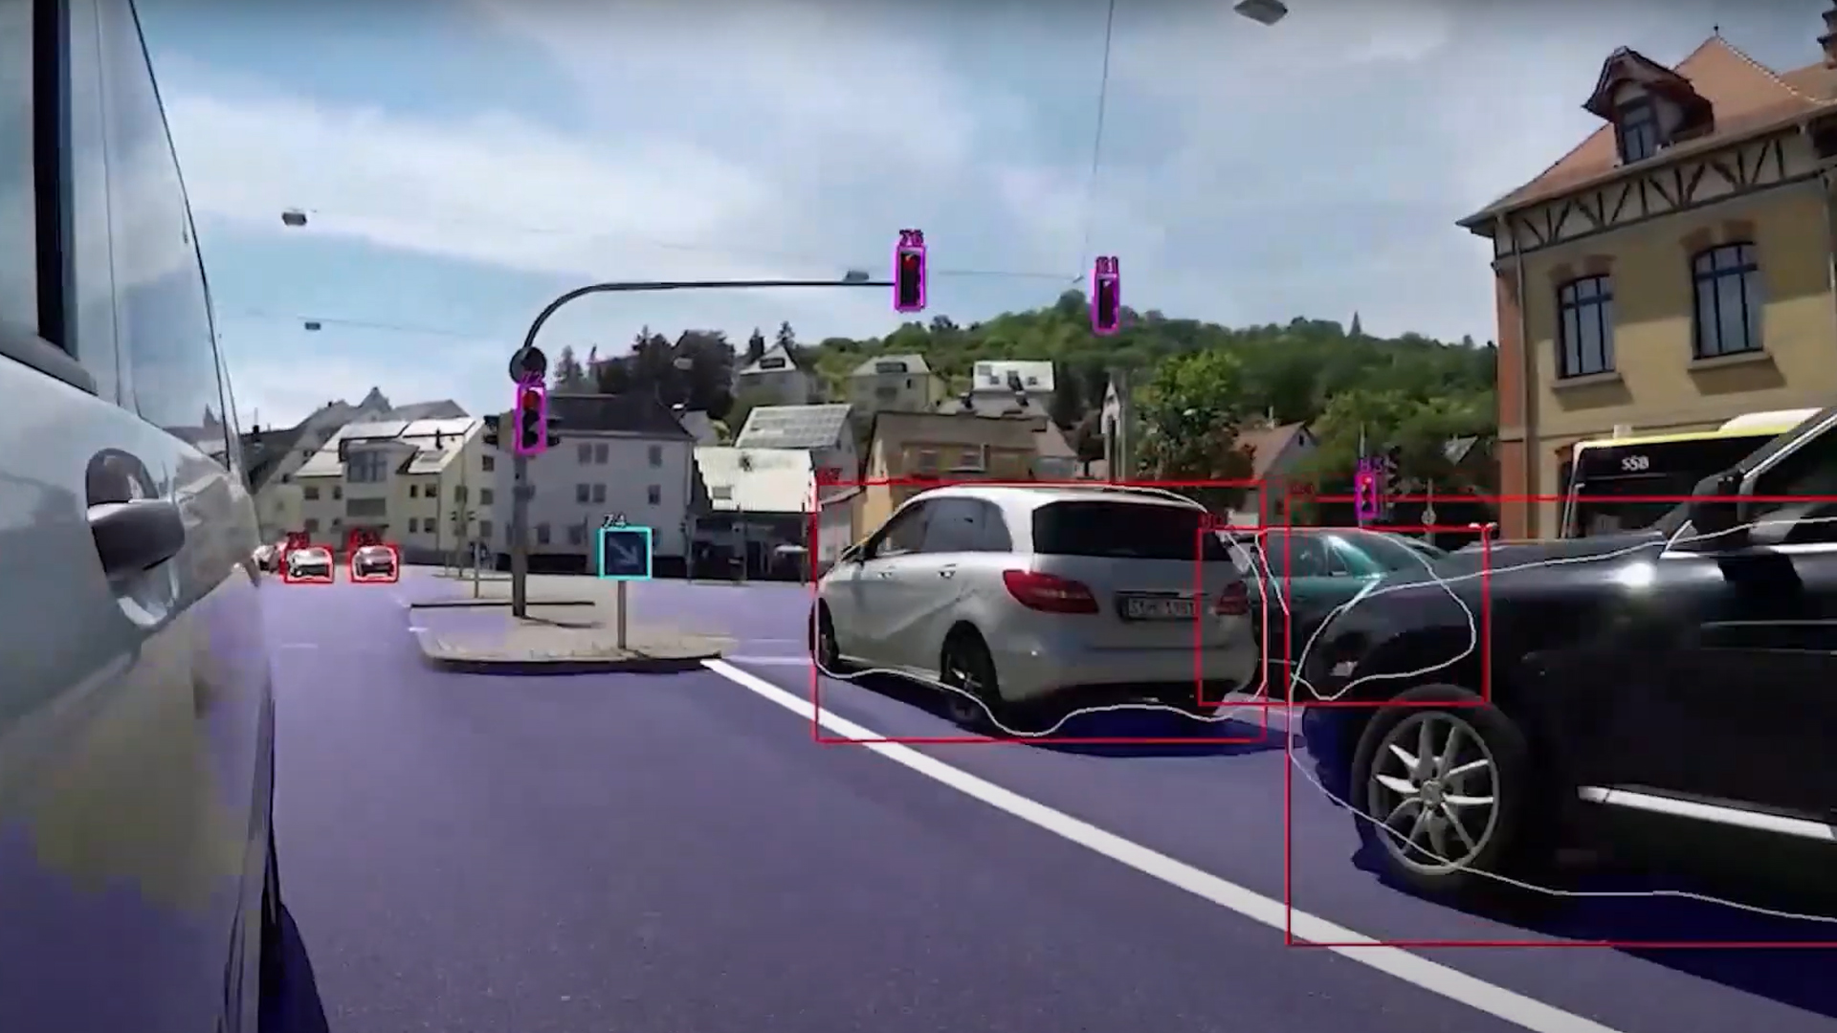
CMS Family - Passenger Vehicles
Segment: Digital vision systems / CMS [passenger vehicles]
Category: Product
Description
Different regions/customers/needs require flexible and cost-efficient solutions. Motherson's CMS product family for passenger vehicles enables customers to reuse Motherson experience, competence and components. Products ranging from entry level CMS to high level CMS incl. ADAS features.
Main advantages
Size reduction
Up to 80% smaller exterior components with significant better direct view
Cost reduction
Providing “design to cost” ready to go solutions and match customer needs
System integration
Typology meets cross vehicle integration requirements.
Enhanced experience
Motherson flexible display offerings as well as camera holders / wings support any new design
Manufacturing improvement
Synergies: Conventional Mirror Tier1 + CMS Tier1 - bundling
Source: Motherson
Key facts
Applications / Compliance
• Best in class image quality in all conditions
• Bright day & dark night, Rain, snow
• Multiple products (BASE – HIGH)
• Different cost levels (Entry – high)
• Supporting BSD, LDW
• Customer design language fully supported
Global & regional homologation Customer certification All components verified by Motherson
Intellectual property
No IP restrictions worldwide except USA
Idea / feasibility study
(TRL 1-3)
Advanced development
(TRL 4-6)
Serial development
(TRL 7-9)
In production
(SOP)
Source: Motherson
Source: Motherson
1
2
3
4
Contact: Maximilian Kauffmann Function: Global Business Development
Division: Vision Systems Company: SMR
Maximilian.Kauffmann@motherson.com Last modified: 14-04-2023

